Slide 1
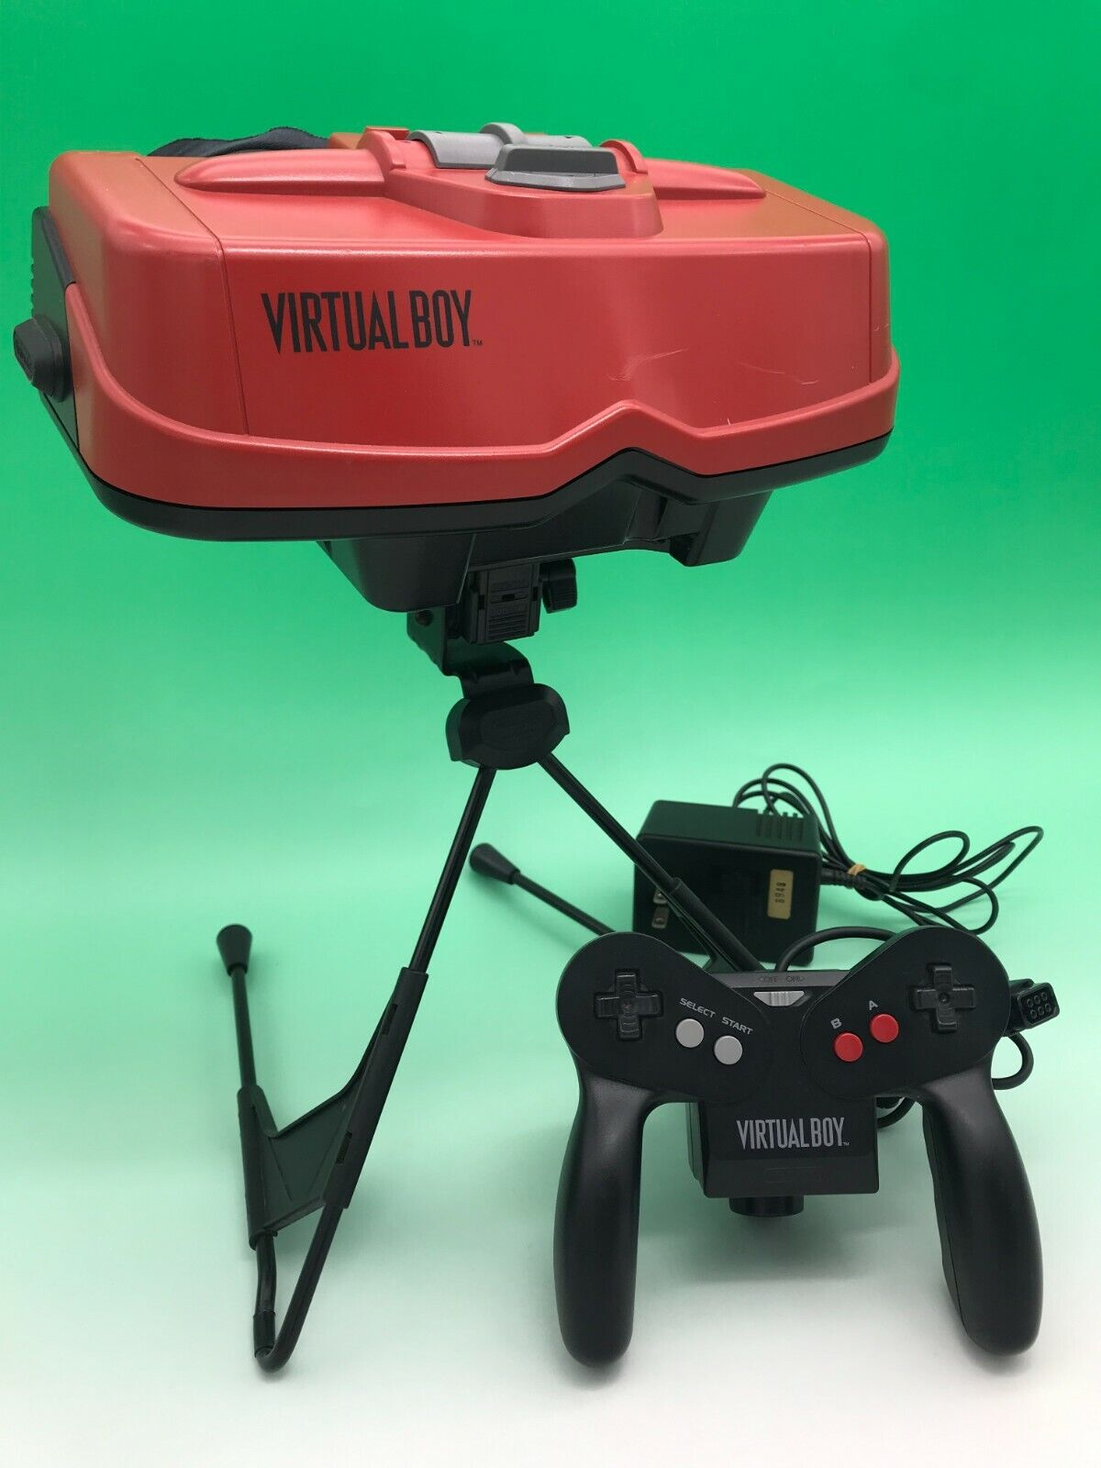
Virtual Boy Failure
Decision and Risk Analysis
Final Project Presentation
Tra (Joey) Hoang, Duc Pham, Kaoshal Rathod, Sathwika Yelamoni

Slide 2
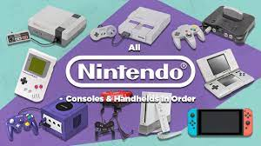
Introduction
Nitendo is one of the biggest game companies in the world with a track of great games Mario and Zelda with high profit
Did you know that this company had to discontinue one of their consoles years ago?
Failure Business Case: Virtual Boy
Release year: 1995-1996
Goal:
What is the company’s product strategy in order to prevent the failure?
New Model Explanation

Slide 3
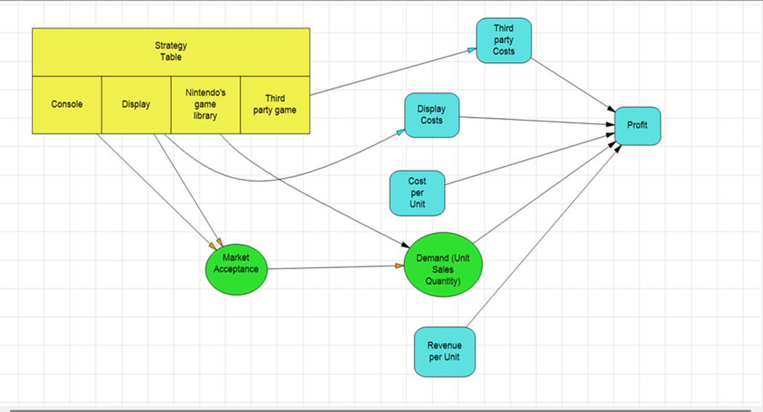
Influence Diagram

Slide 4
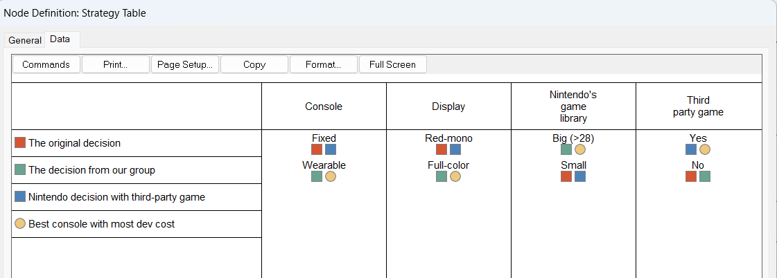
Strategy Tabel
4 strategies:
- The original decision from Nintendo
- Group decision for best profit
- Nintendo decide to add more games from third-party
- Nintendo build the best console ever but with highest spending

Slide 5
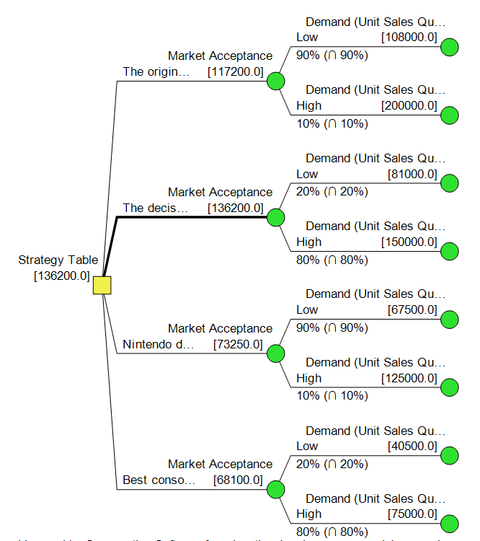
Policy Tree
Based on the analyze of the model, policy tree show the optimal decision strategies which have the best expected value which is from our group decision.

Slide 6
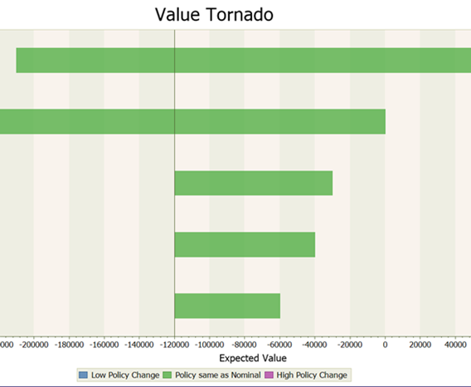
Value Tornado
The Tornado is showing that Revenue per Unit and Cost per Unit have the most impaction on the profit of Nintendo. Followed by other cost, product sold quantity.

Slide 7
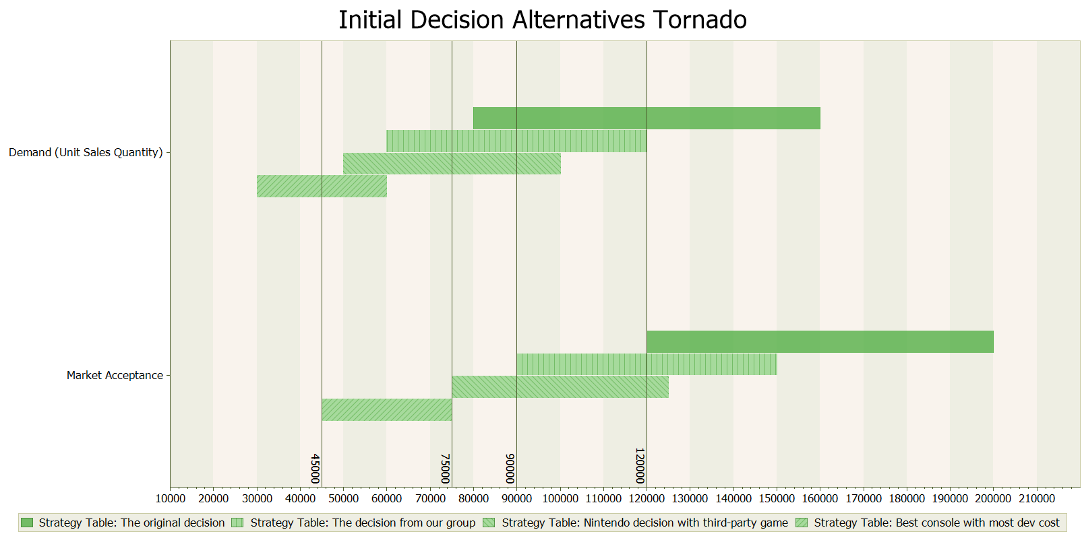
Initial Decision Alternatives Tornado

Slide 8
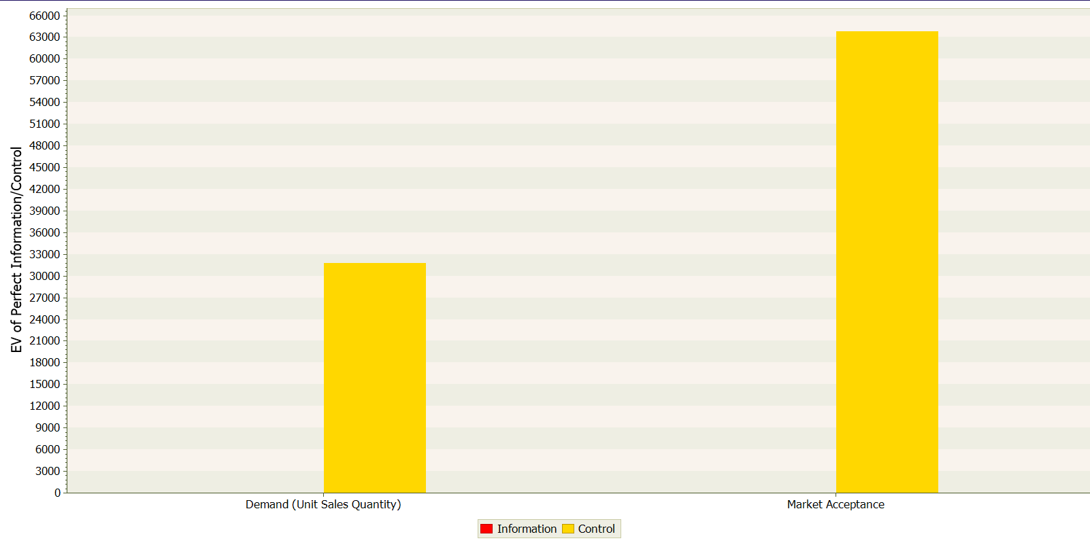
VOIC Analysis
Market acceptance control stands out with a higher expected value (6300 to 6400) in contrast to demand control for the Virtual Boy model. Enhance the Virtual Boy's market position as a 3D console, a focus on improving marketing strategies is recommended.

Slide 9
What else the model could be use
- Nintendo initially sold the Virtual Boy at $180 per unit, but due to high costs and failed marketing, they slashed the price to $99.
- Despite selling 770,000 units, development costs had already surpassed $1 million, suggesting a slim profit margin.
- The release of the Nintendo 64 alongside the Virtual Boy (which sold 4.7 million annually) could have contributed to the latter's discontinuation.
- Applying decision analysis, new strategies could include making the console wearable, enhancing display colors, expanding the game library, and collaborating with third-party developers to boost marketing and appeal as a 3D console.

Slide 10
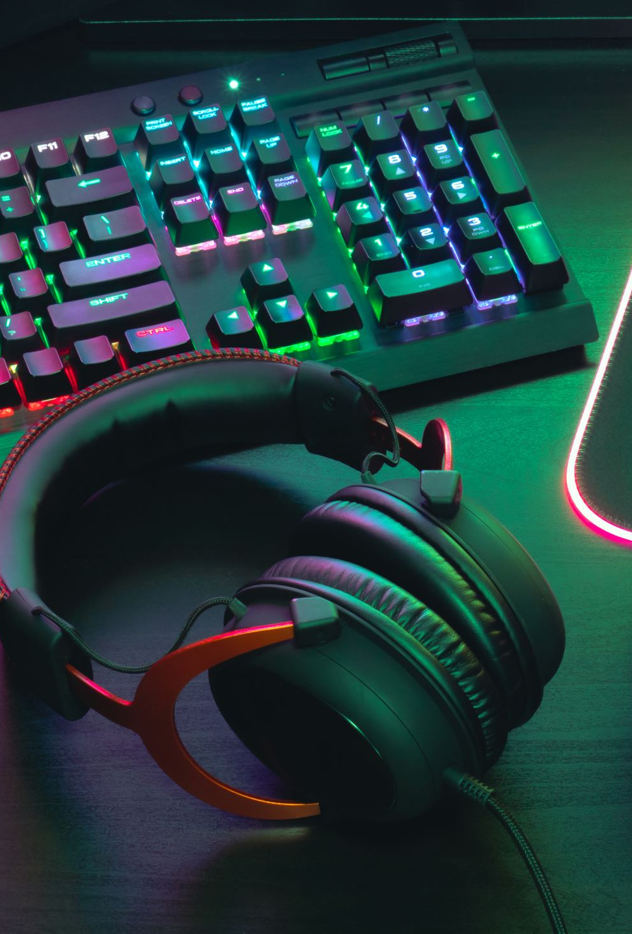
Final Result
- Looking at the results, there are ways this company can improve their console's strategy to keep it going instead of shutting it down.
- They had a good idea with the 3D console, but the technology and plans they had back then weren't enough to make it work well.
- To succeed, they need better tech and smarter plans for their product.

